Slide 1
Investigating the Impact of the COVID-19 Pandemic on the American Stock Market
Andres Portes, Ella Ndalla, Ridhwaan Ali

Slide 2


Our Objective
Objective: to understand the pandemic’s impact on the US stocks performance through the New York Stock Exchange, and advantageously use the lessons learned to better anticipate future stock market performance and leverage economies of scale in case another pandemic is ever declared.

Slide 3


Research & Focus
Our research explored stock performance on the NYSE by sectors based on the The Global Industry Classification Standard.
Our research period spanned from March 2019 to March 2023. This time frame provided coverage of stock performance prior to the pandemic, during the pandemic and the recovery period. The dataset highlighted the impact the pandemic had on the stock market and provided indication on whether or not the US stock market was currently performing under its pre-pandemic conditions.

Slide 4

Initial Analysis and Key Findings
We initially took a look at the S&P 500 index, which is widely regarded as a benchmark for the overall performance of the stock market, to get an initial idea of the landscape. It fell more than 34% between its peak in February 2020 and its low point in March 2020.
Some industries, such as healthcare, technology and e-commerce, thrived during the pandemic as consumer behavior was altered and more people most likely turned to online pharmacies, home-based operations and online shopping over traditional stores. As a result, the stock prices of the companies in these sectors soared.
As many of us know, the pandemic ended up having a significant impact on the world economy, leading to unprecedented volatility and uncertainty that lingers to this day. It is undeniable that a few key trends and developments emerged as a result.
On the other hand, the industries that were hit hard by lockdowns and other pandemic-related restrictions, such as travel, hospitality and retail, saw their prices suffer. Many companies in these sectors were forced to lay off a vast number of their workforce, while others went bankrupt, which most likely lead to the decline in stock prices.

Slide 5
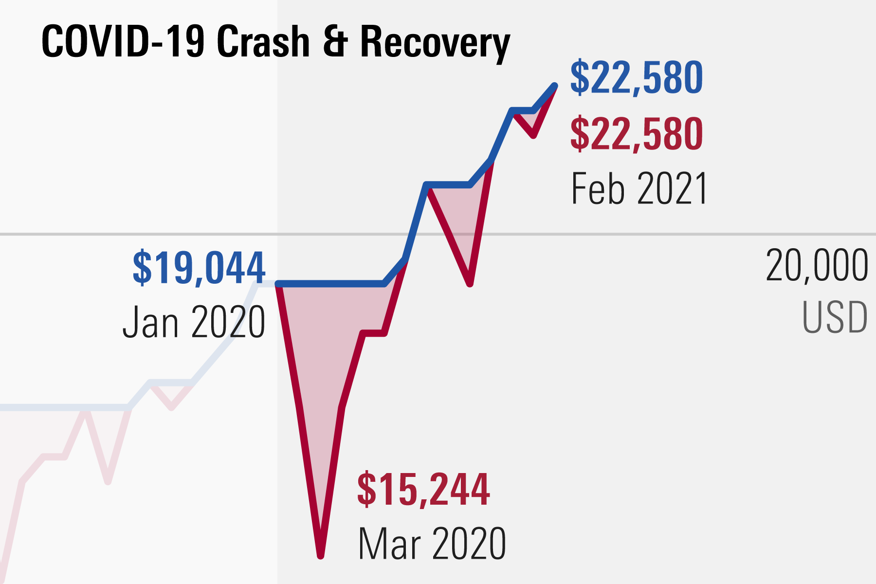
Notes:
The Duration

Slide 6

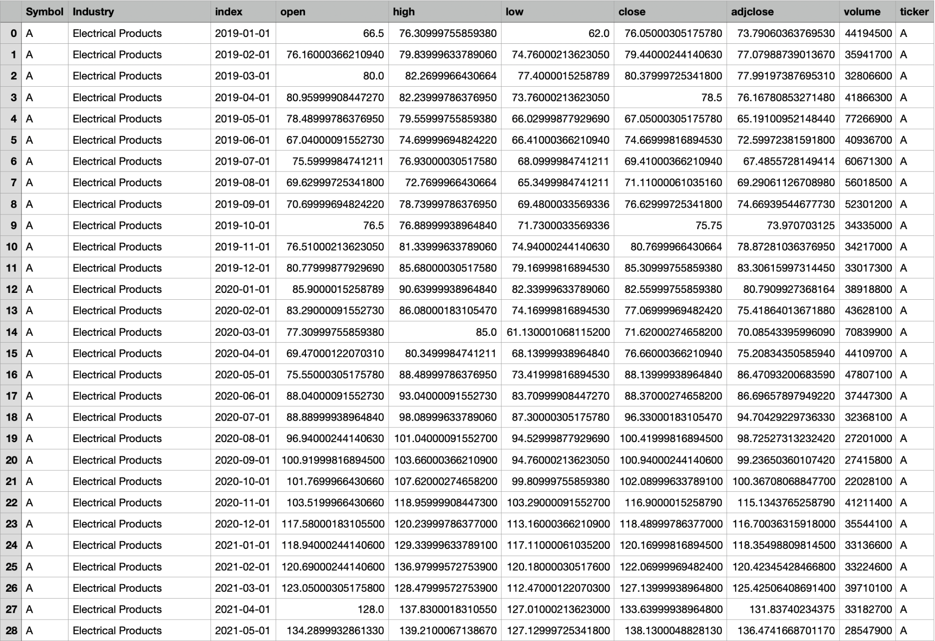
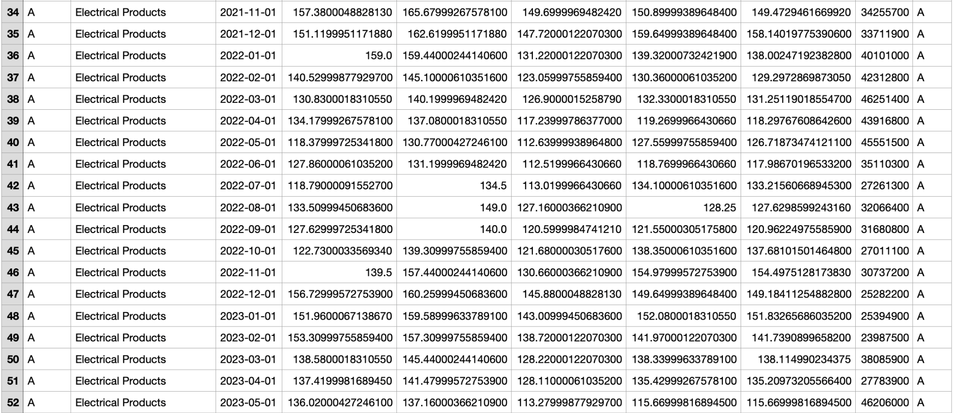
Retrieving Historical Data
We used API’s to import stock data from the NYSE to have historical data. We were able to find CSV files and convert them into data frames to fetch the historical data and stock results from the NY Stock Exchange that dated back years before the start of the pandemic. Ref. (2019-2023).The data told us everything.

Slide 7

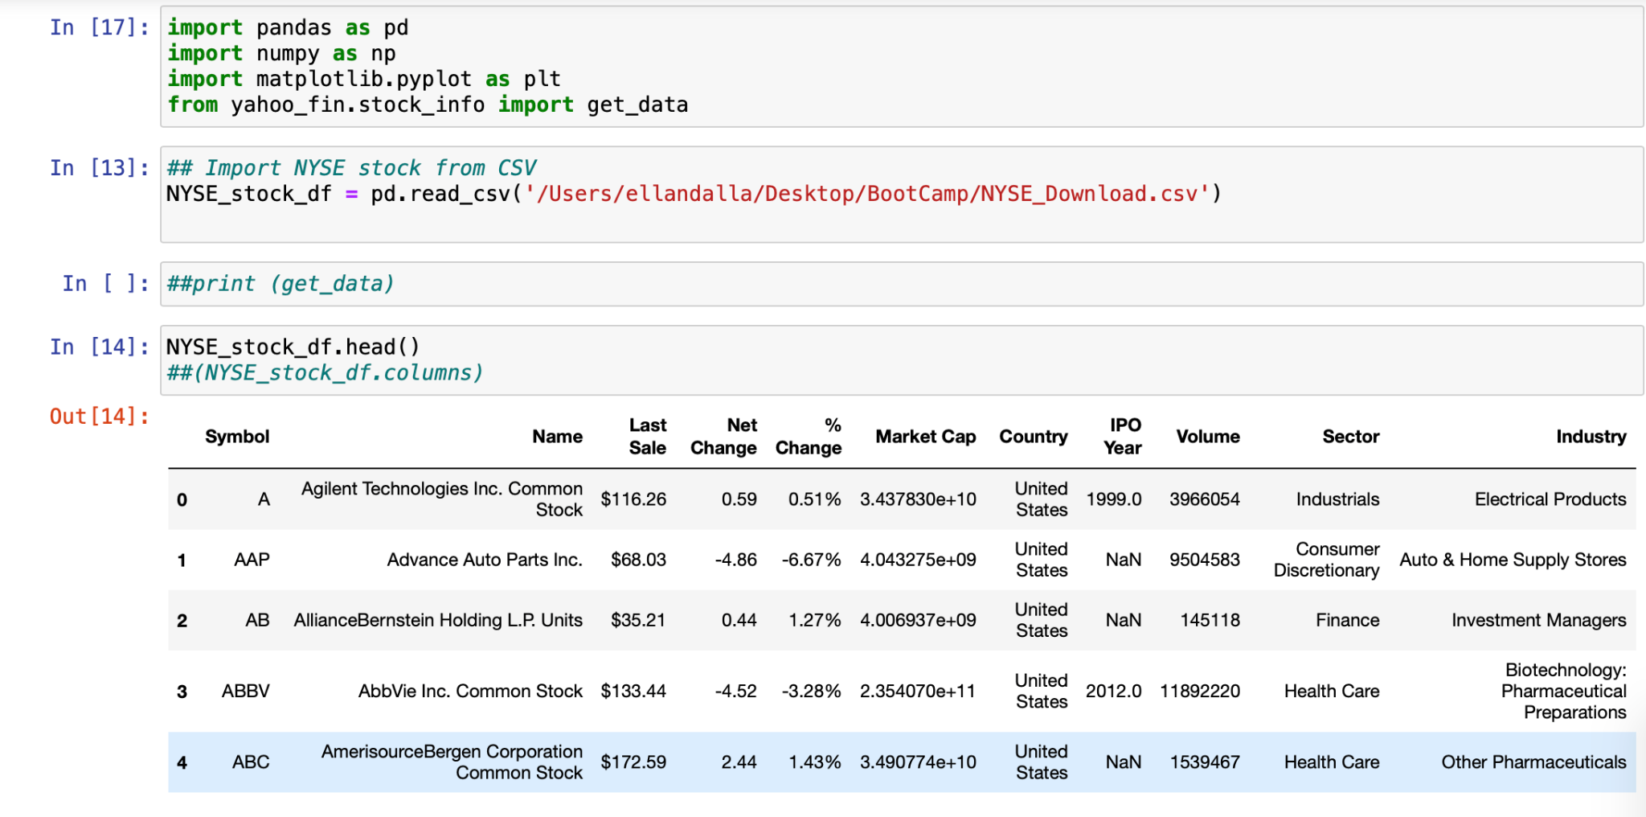
Using API and Python to Retrieve Accurate Data and Sources

Slide 8
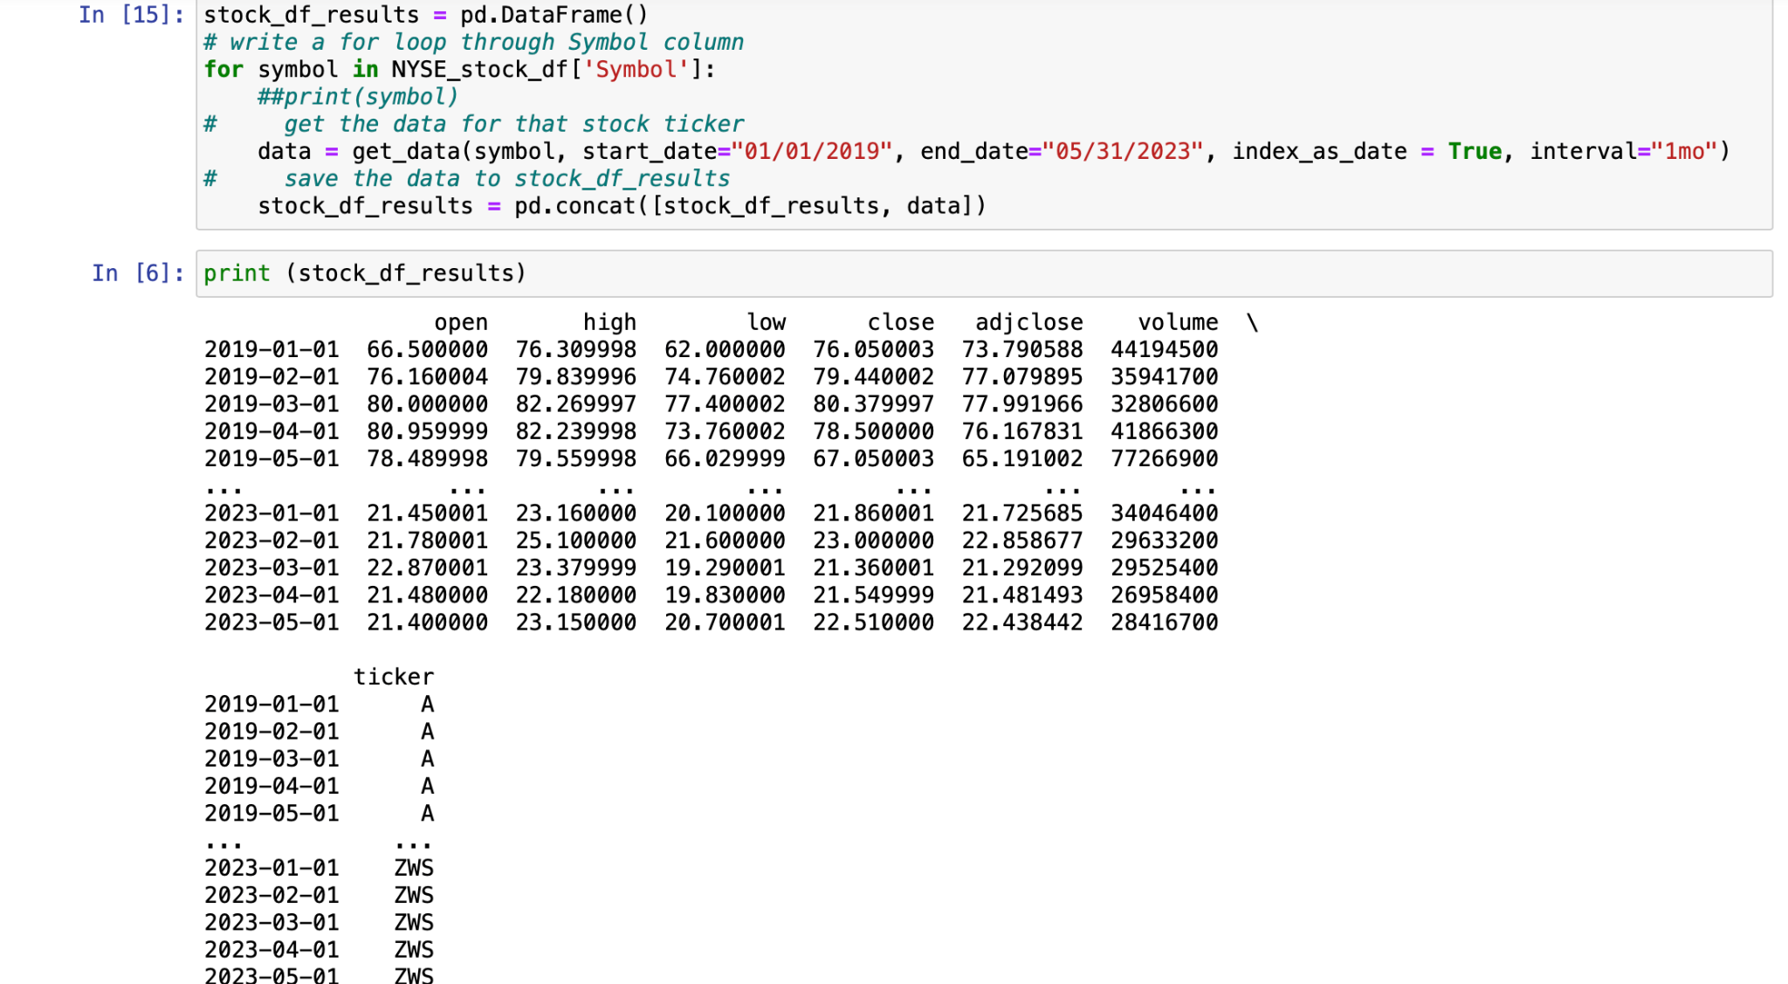
Continuation of Processing Data and Sources

Slide 9
Analysis
We reduced the data frame to able to plot the data.
The CSV contained all the data from 2019-2023 so we made separate variable data for each year.
We chose to make the index the x axis and the volume the y axis.

Slide 10
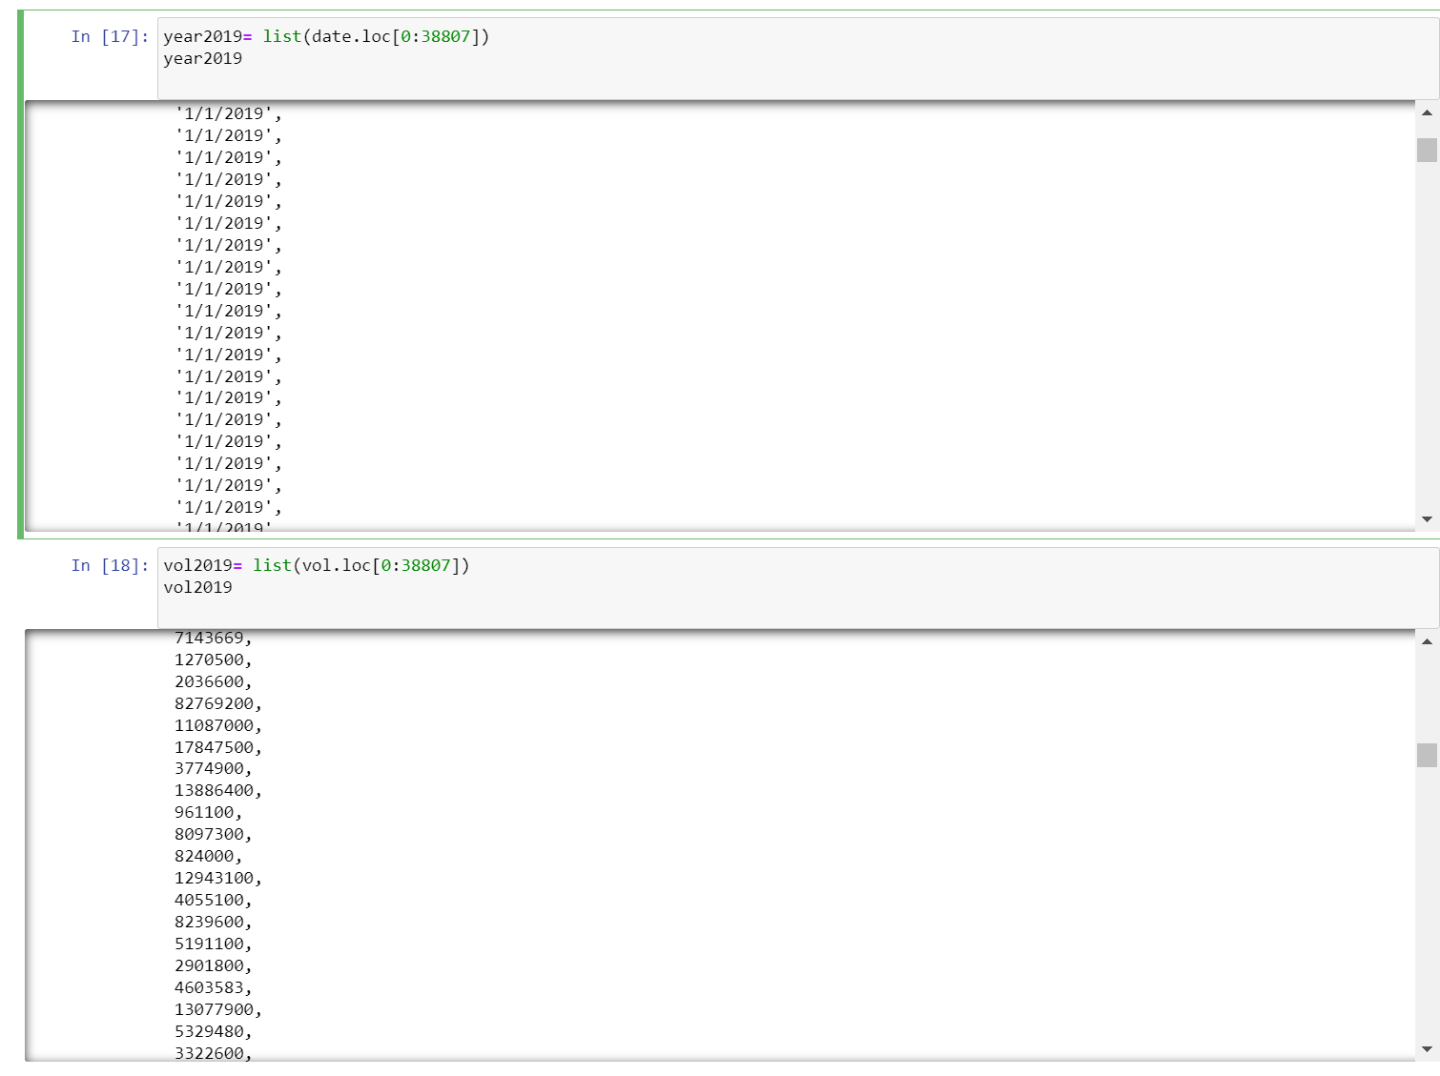

Slide 11
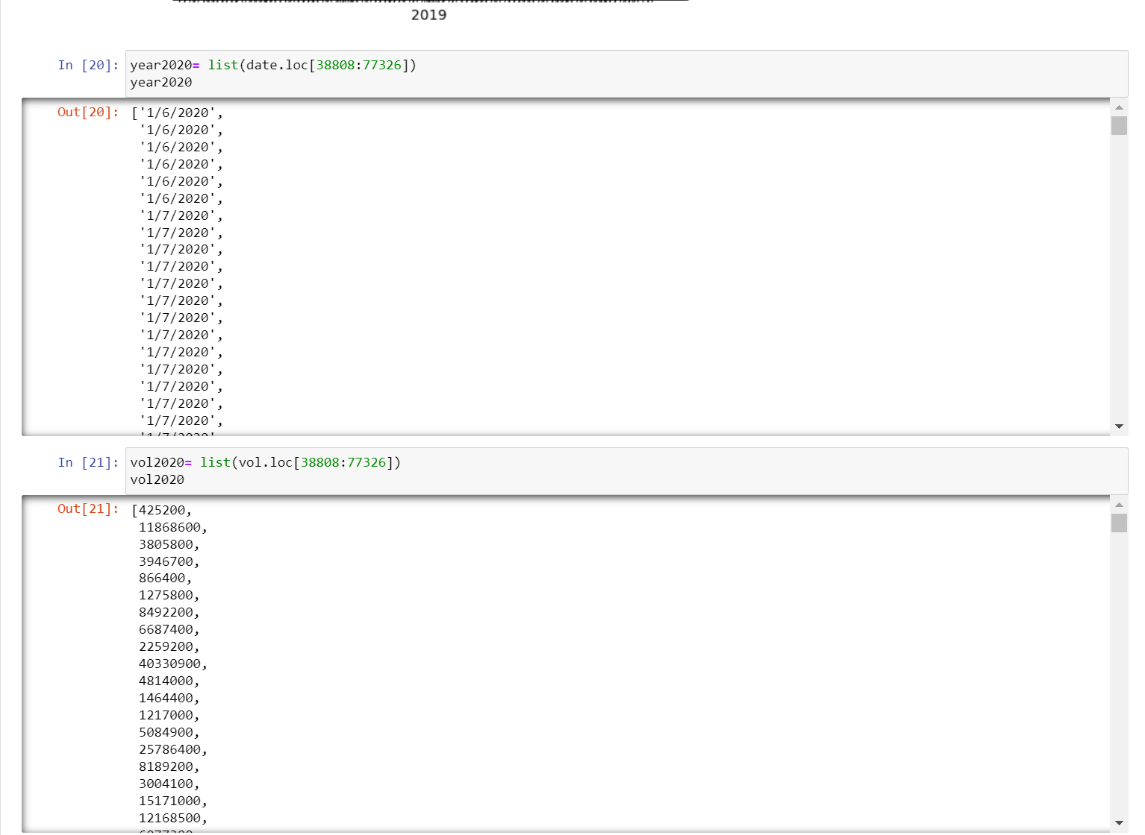

Slide 12
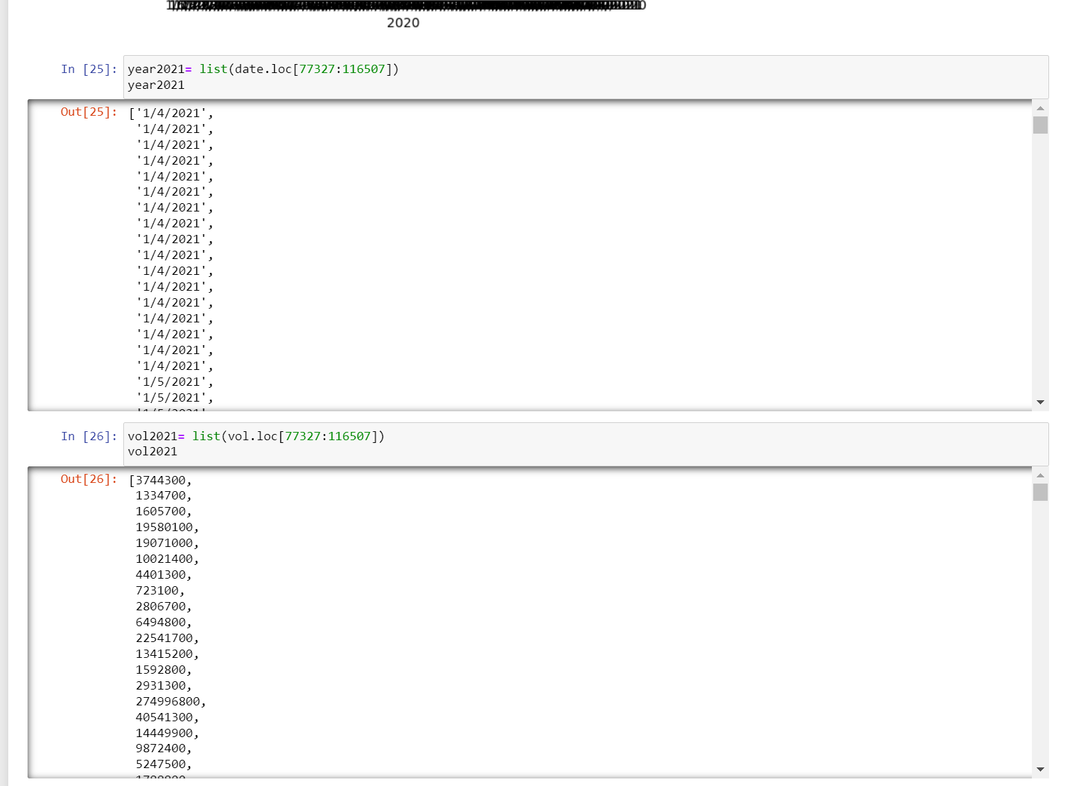

Slide 13
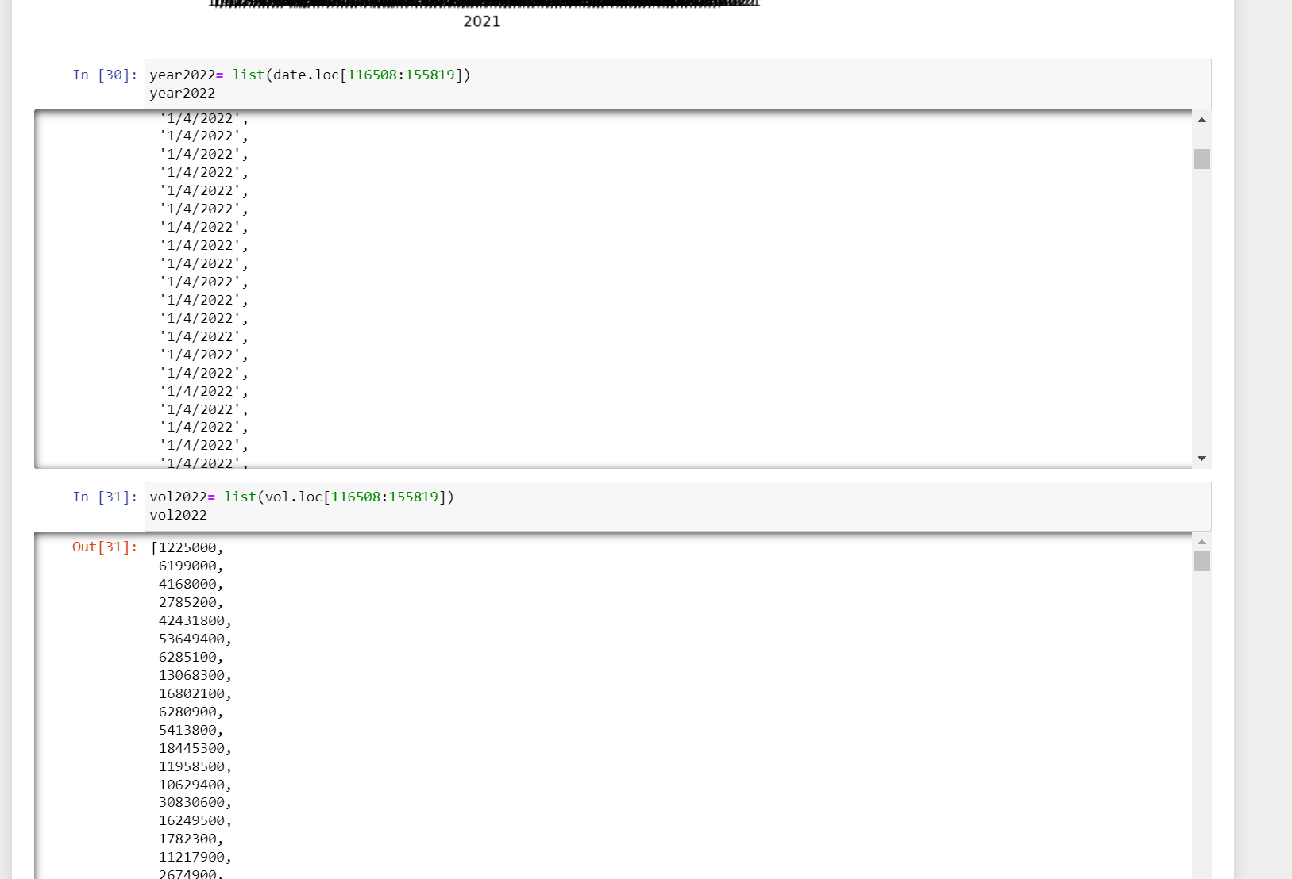

Slide 14
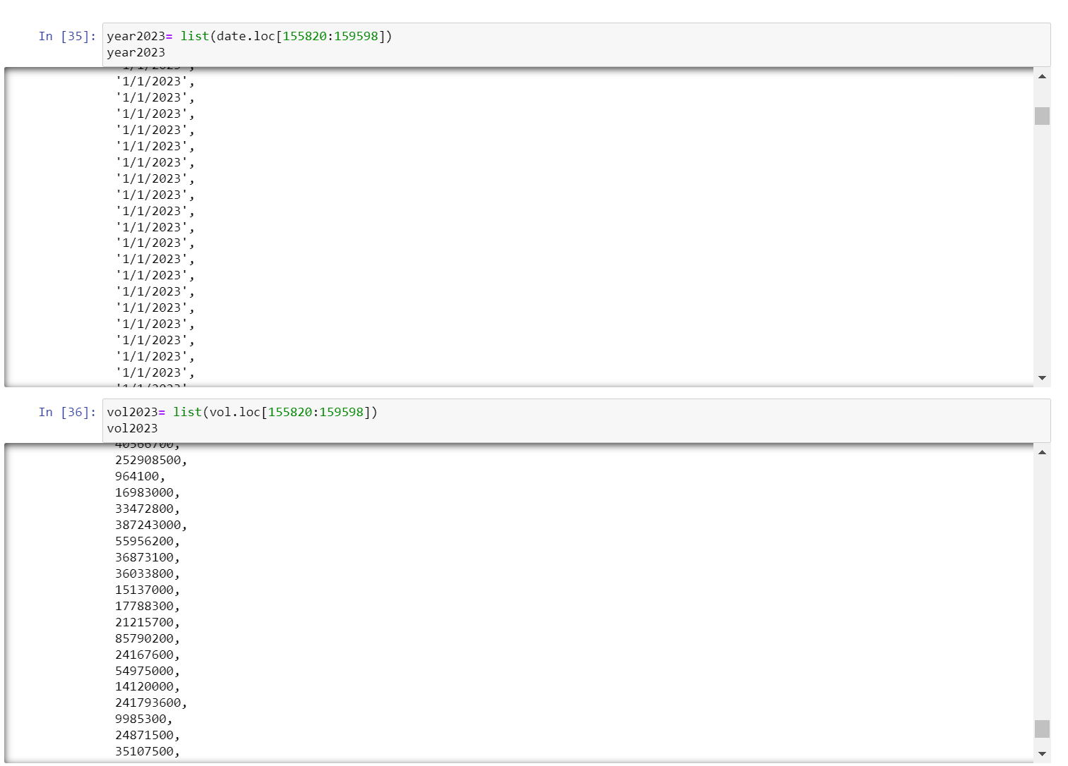

Slide 15
Visualization of Analysis
After declaring our x and y variables for plotting we were able to create line plots that show trends in the volumes for each separate year.
We also made another set graph that was grouped by sector and graphed it by year and price

Slide 16
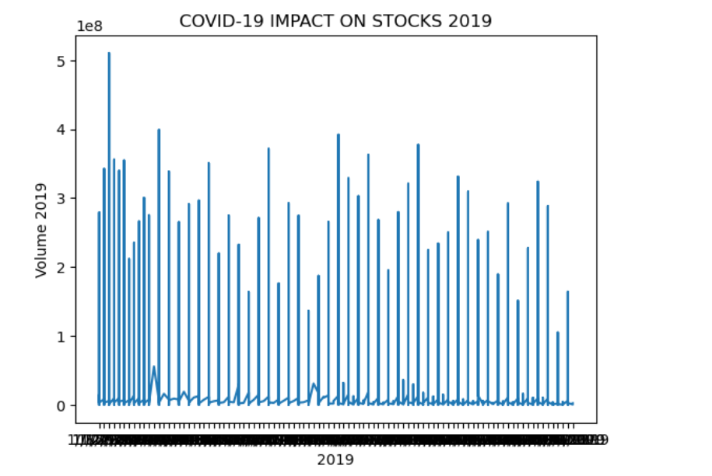

Slide 17
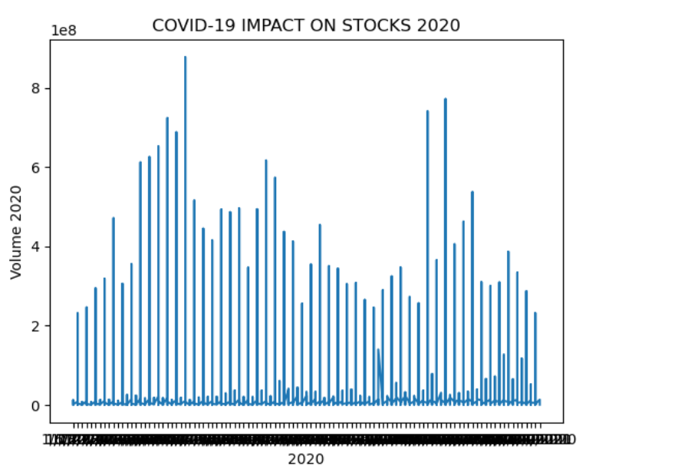

Slide 18
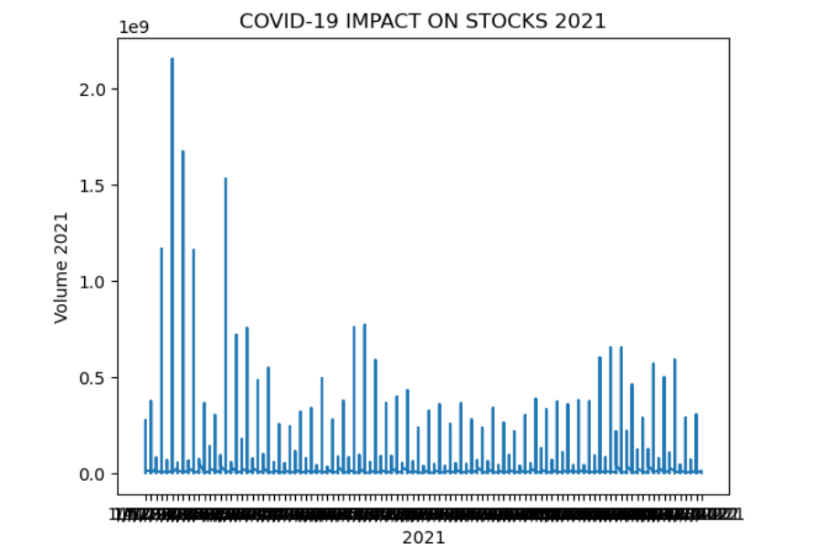

Slide 19
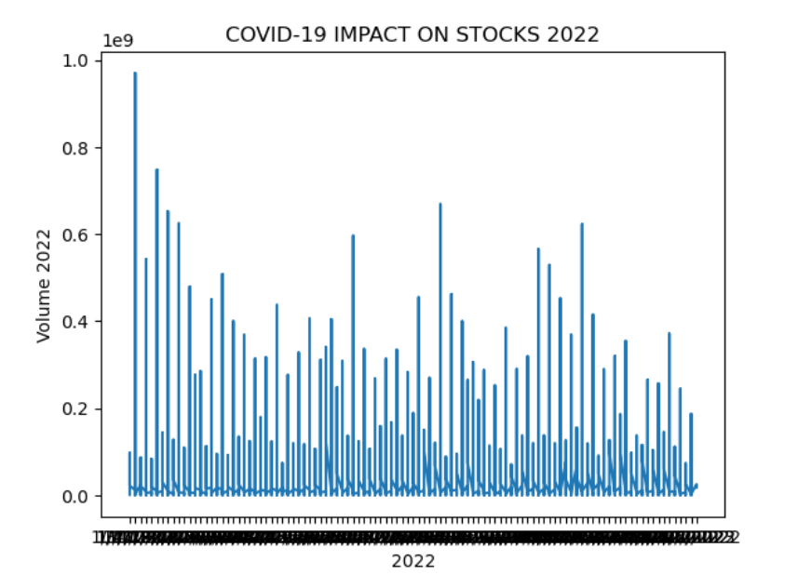

Slide 20
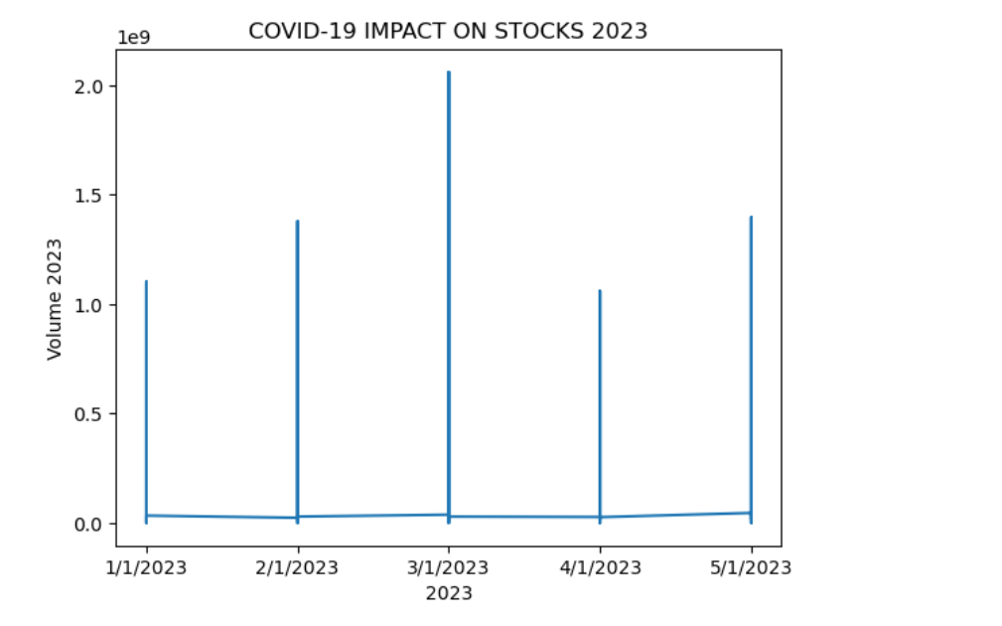

Slide 21
Results + Recommendations
During unprecedented times like the COVID-19 pandemic, it becomes important for business leaders to focus on maintaining a strong financial position. Businesses now have no choice but to learn how to implement cost-saving measures, diversify revenue streams and invest in new technologies. During the pandemic, It became evident that building a strong, resilient and adaptive culture helps face the challenges and uncertainty of the stock market today, as well as the future.
Overall, it is undeniable that the Covid-19 pandemic had a significant impact on the stock market. It led to unprecedented volatility and changes in the way that stocks were traded around the world. The past few years were certainly a wake-up call for anyone or company who was conditioned to the success strategy of buying in the dip and selling when resources are overvalued. As the world continues to grapple with the impact of the pandemic and its economic impact, it is likely that we will witness the stock market continue to be affected in a variety of ways. The only way to combat this, is to be proactive, not reactive. The companies and sectors that used technology and resources to create a culture that did not solely rely on providing one single service, or services that limited themselves to one way of making contact with the consumer.

